Slide 1


CliMAF Earth System Model Evaluation Platform
Evaluating/comparing a set of simulations/models on Ciclad and Curie: part 1

Slide 2
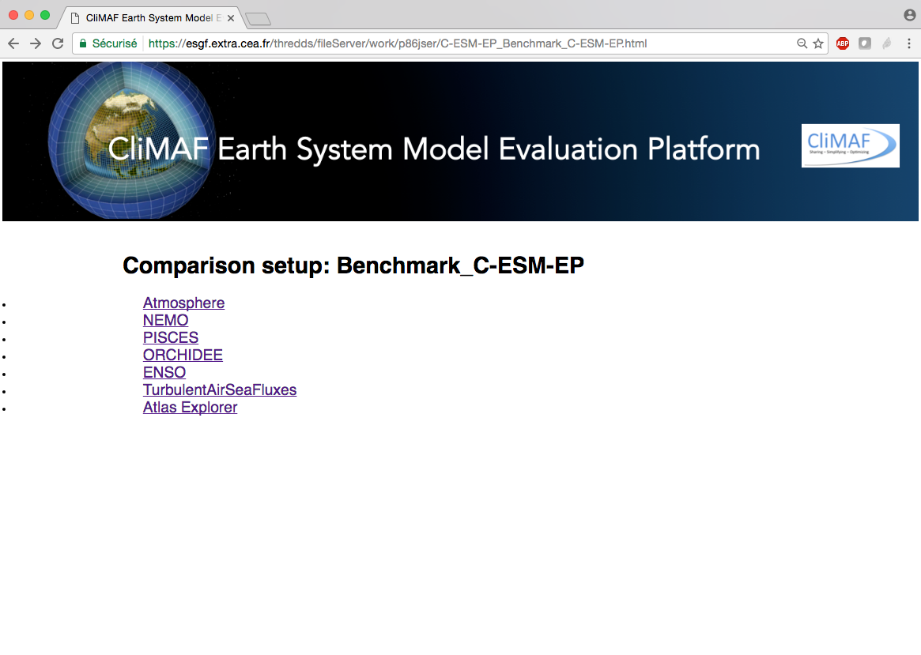
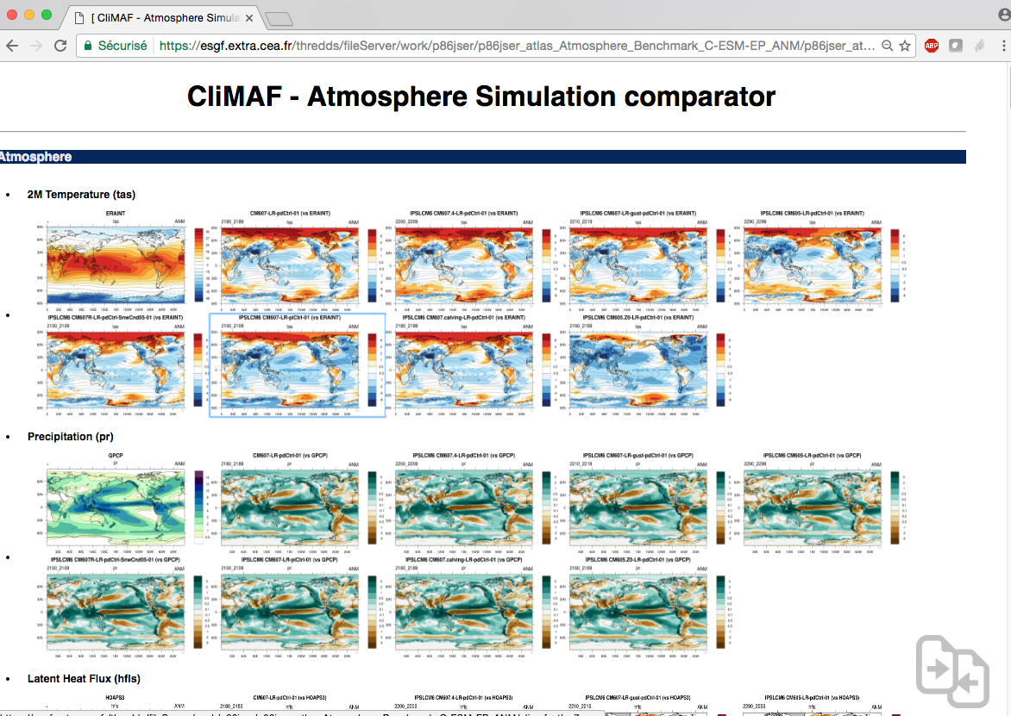
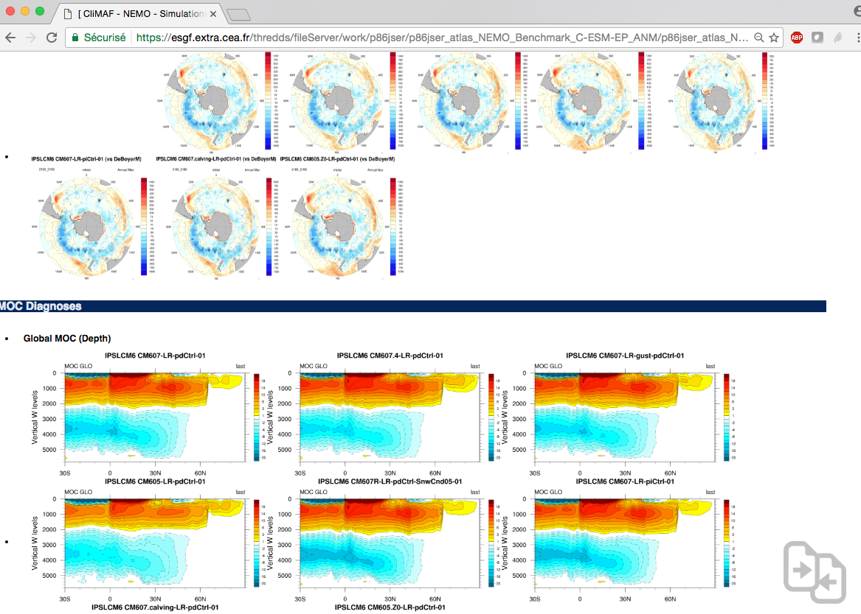
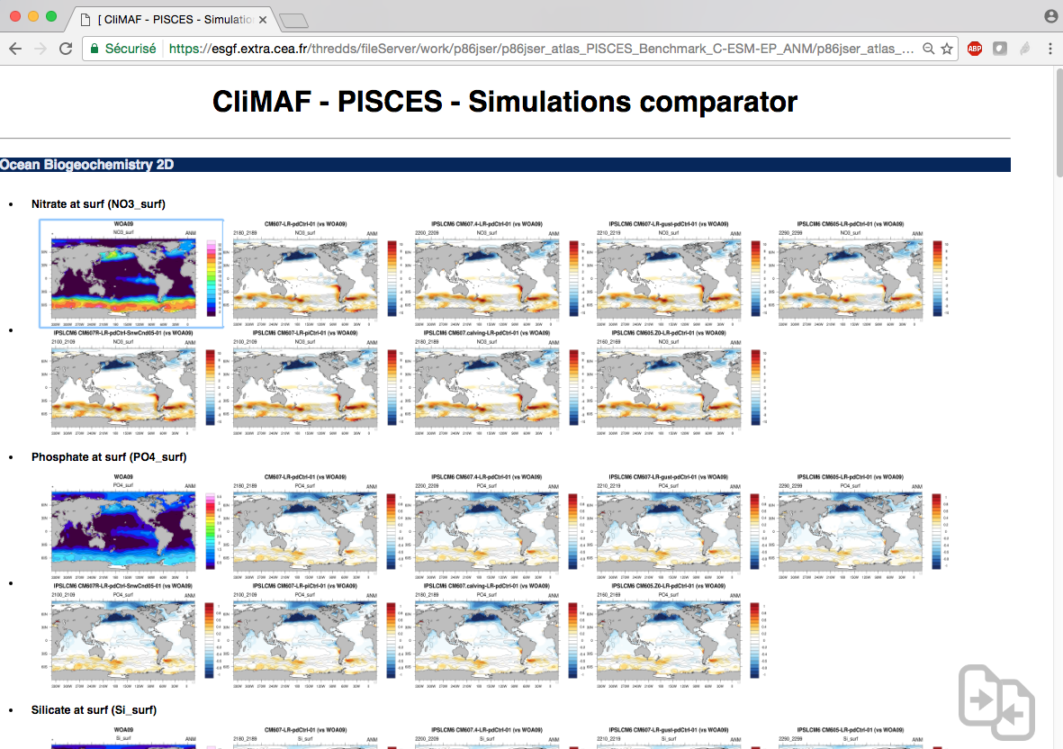
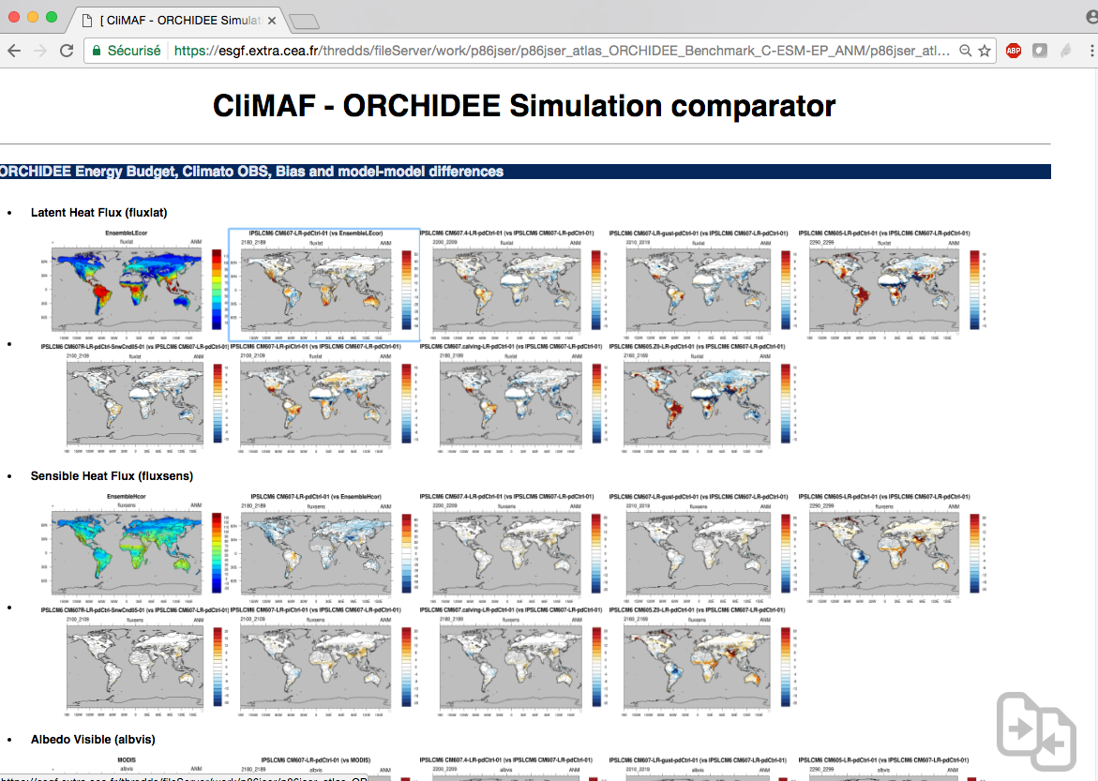
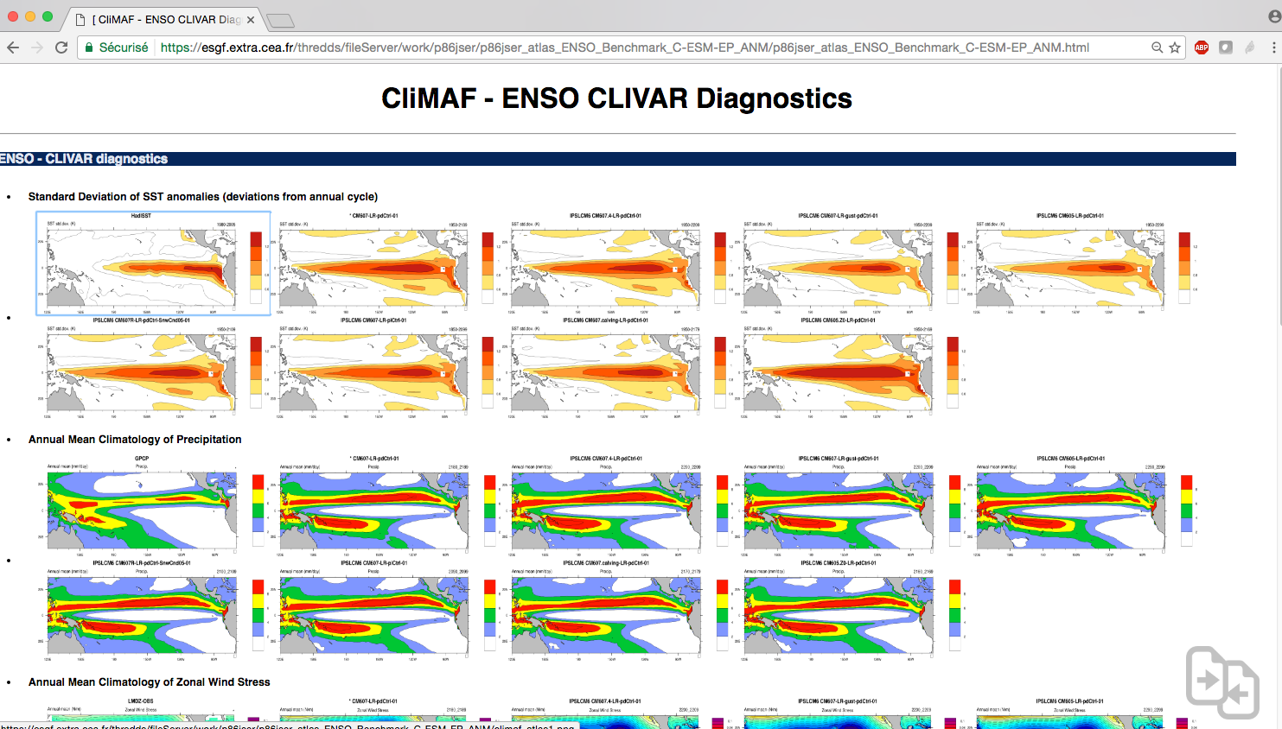
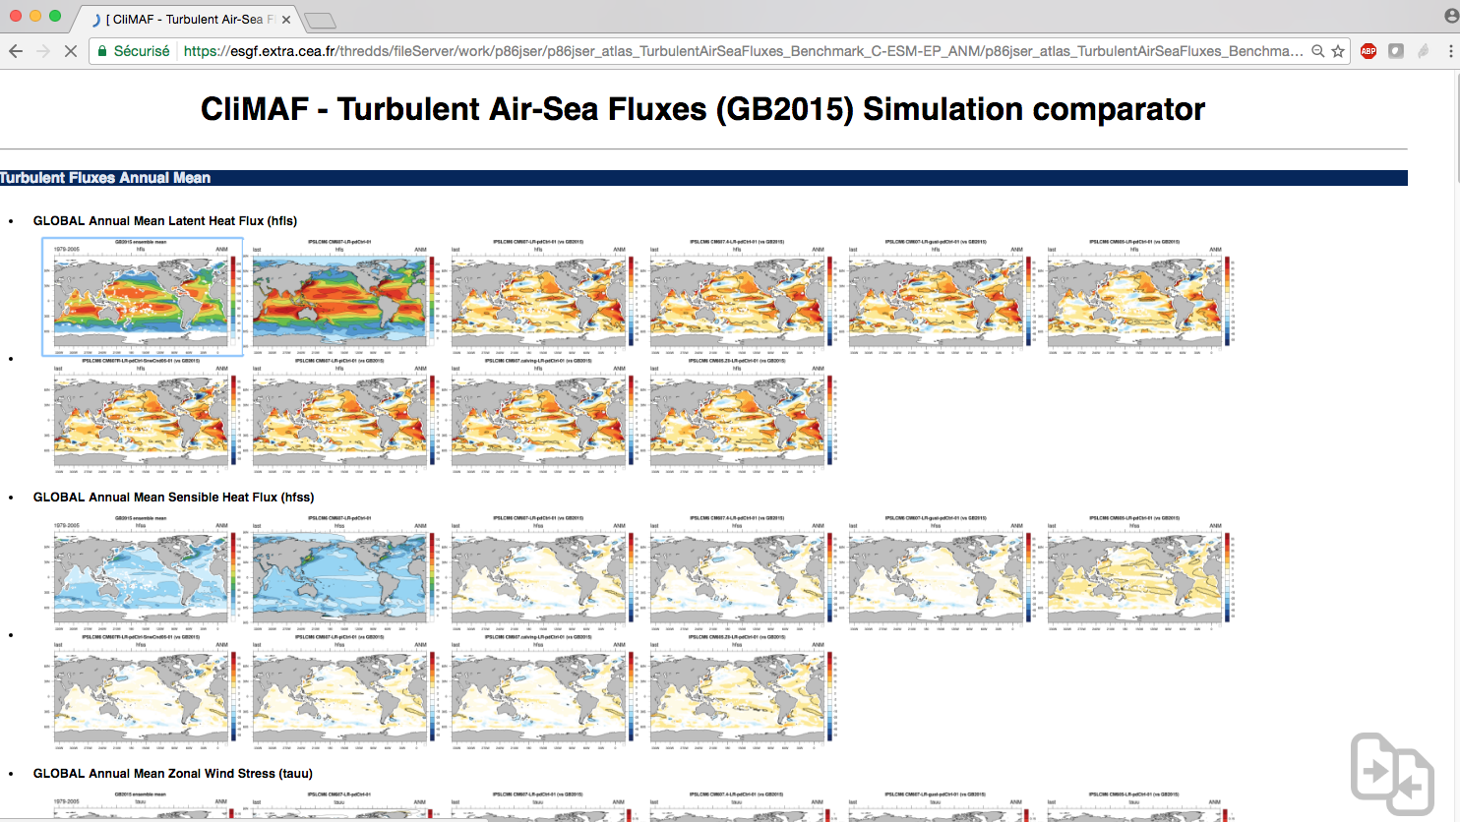
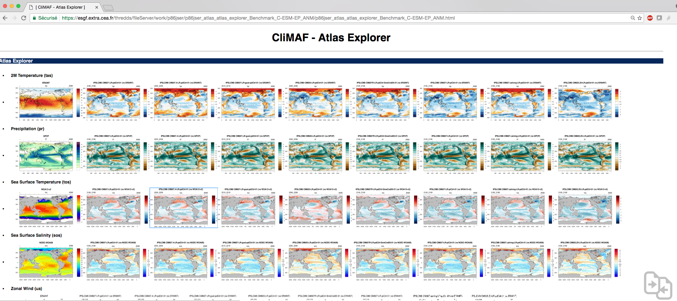

Slide 3
Outline
C-ESM-EP quick manual
In this documentation you will find the basis to get started with the C-ESM-EP. We will see how to:
setup a C-ESM-EP working directory and run the standard comparison
specify your datasets (examples with the IGCM_OUT and CMIP5 projects)
Use the period manager functionality to find the available period
optimize it with set_available_period_ts_clim.py
Use colors to identify your datasets
Let’s start!

Slide 4
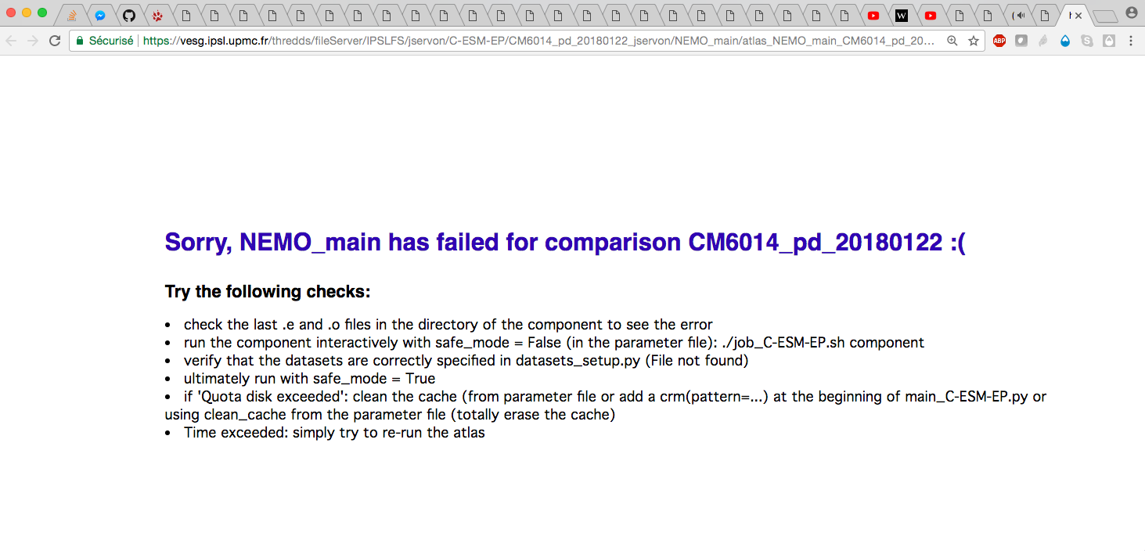
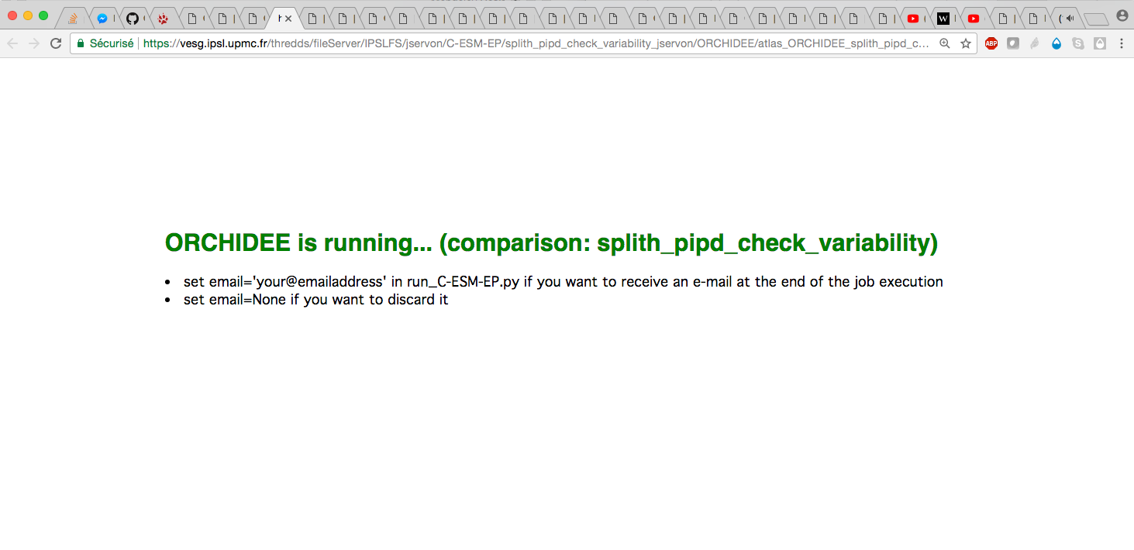
New features of the last version
Routine cleaning of the cache controlled from the parameter file
Set_available_period_ts_clim.py: this script will apply the time_manager only once (instead of applying it for each diagnostic) to find the available periods corresponding with the user request like clim_period=‘last_30Y’ or ts_period=‘full’; This saves a lot of time, particularly when working interactively and doing small adjustments
Receive an e-mail at the end of the execution of the jobs
Running a set of components with one argument with run_C-ESM-EP.py (LMDZ, NEMO, LMDZOR…); potentially add your own selection in run_C-ESM-EP.py
Running/failed messages at the atlas address if the atlas is runnning or has failed (this latter contains some instructions to investigate why it failed)

Slide 5
Setup a C-ESM-EP working directory

Slide 6
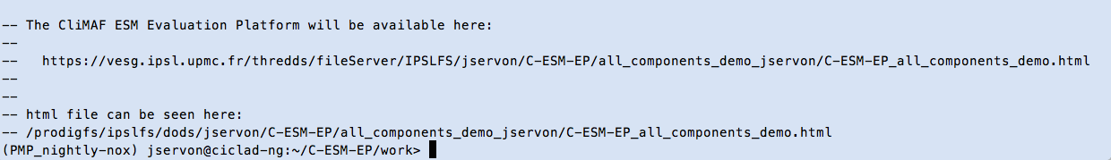
The C-ESM-EP in a nutshell
The quick way to use the C-ESM-EP
Copy the sources in a working directory:
cd my_working_directory
git clone https://github.com/jservonnat/C-ESM-EP.git #(from Ciclad)
or
git clone jservon@ciclad.ipsl.jussieu.fr:~/C-ESM-EP/git C-ESM-EP #(Curie)
Setup your comparison:
cd C-ESM-EP
cp -r standard_comparison/ my_comparison/
Run all the components together or just a subset:
python run_C-ESM-EP.py my_comparison [compX,compY]
See the results on the URL returned by run_C-ESM-EP.py

Slide 7
The C-ESM-EP in a nutshell
Pre-defined sets of components
The user can run targeted components from run_C-ESM-EP.py:
python run_C-ESM-EP.py my_comparison [compX,compY]
But there are also some pre-defined sets of atlases that you can run with the following arguments:
python run_C-ESM-EP.py my_comparison OA
=> 'Atmosphere_Surface', 'Atmosphere_zonmean', 'NEMO_main', 'NEMO_zonmean',
'NEMO_depthlevels', 'Atlantic_Atmosphere_Surface', 'ENSO', 'PISCES’
python run_C-ESM-EP.py my_comparison LMDZ
=> 'Atmosphere_Surface', 'Atmosphere_zonmean', 'Atmosphere_StdPressLevs’
python run_C-ESM-EP.py my_comparison LMDZOR
=> 'Atmosphere_Surface', 'Atmosphere_zonmean', 'Atmosphere_StdPressLevs', 'ORCHIDEE’
python run_C-ESM-EP.py my_comparison NEMO
=> 'NEMO_main', 'NEMO_zonmean', 'NEMO_depthlevels’, ‘PISCES’

Slide 8
Get the sources / update
Warning / Things to know
If you have started a new working directory (cloned the sources) or you just updated your sources:
start your new comparison from comparison_example and not from an existing old comparison directory
You can always copy manually the list of simulations (‘models’) in the new datasets_setup.py file.
Also, if you have specific features in your old parameter files, add them to the new ones.
!!! If you are not using the right parameter files with your version of main_C-ESM-EP.py, you will either not use the last developments or have errors.
Keep only the components you need in your comparison directory:
Avoid running diagnostics that you won’t look
It will clarifiy the C-ESM-EP frontpage: you will only have the links to the available components

Slide 9
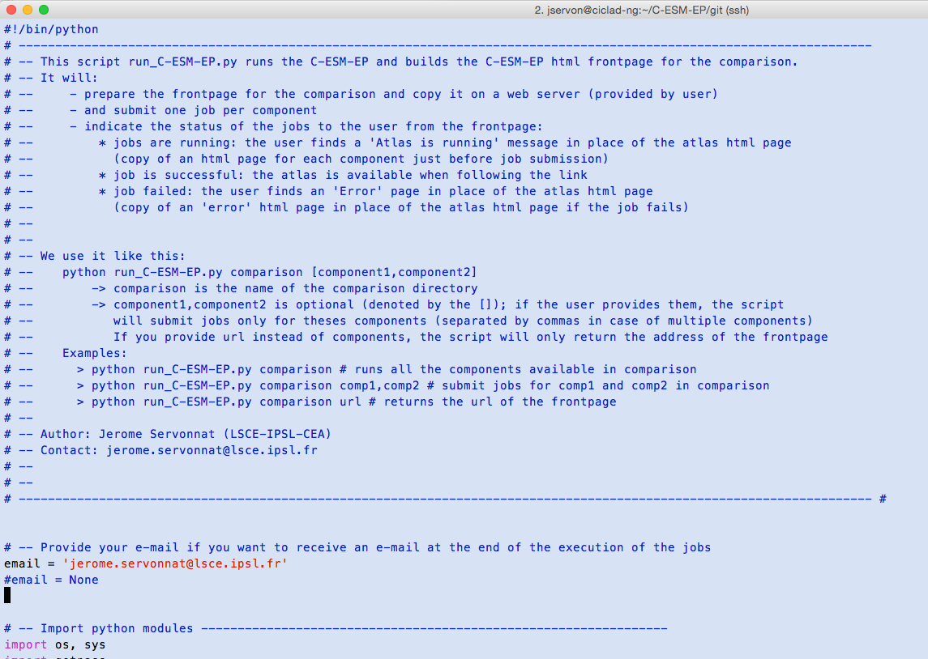
Setup the automatic e-mail
run_C-ESM-EP.py
This is the first thing you have to do after installing your C-ESM-EP: edit run_C-ESM-EP.py to either provide your e-mail if you want to receive one at the end of a job, or set email=None to discard this functionality.
You can also provide multiple emails separated with commas:
‘name1@address.com,name2@address.com’

Slide 10
Add your own datasets

Slide 11
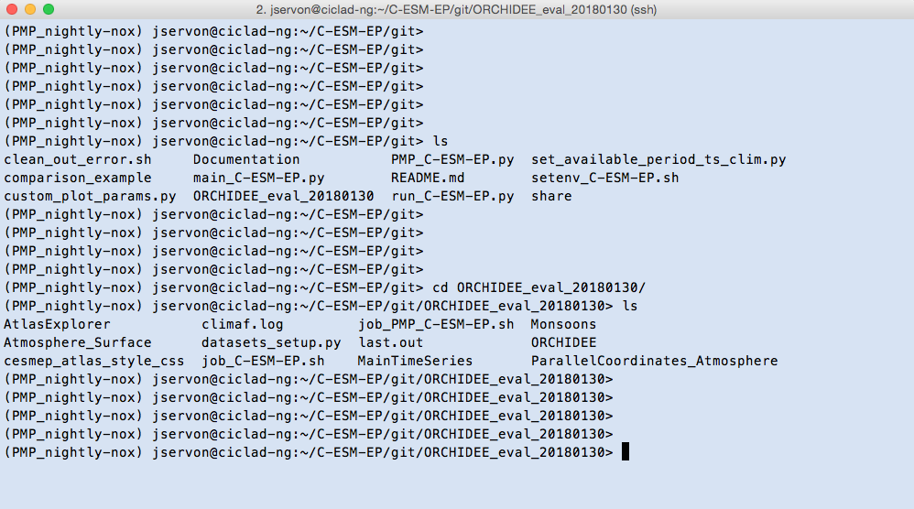
Adding your simulations
datasets_setup.py
The data you want to work on is described by a CliMAF 'project' (data tree + variable names aliases)
The data has to be CF-compliant (norm on the metadata in the files, especially the dimensions)
We encourage working with CMIP variable names
No overlapping files in your data directories (do not have multiple files covering a common period for the same variable in the same data tree)
In my working directory on /home
Comparison directory: ORCHIDEE_eval_20180130
Vi datasets_setup.py

Slide 12
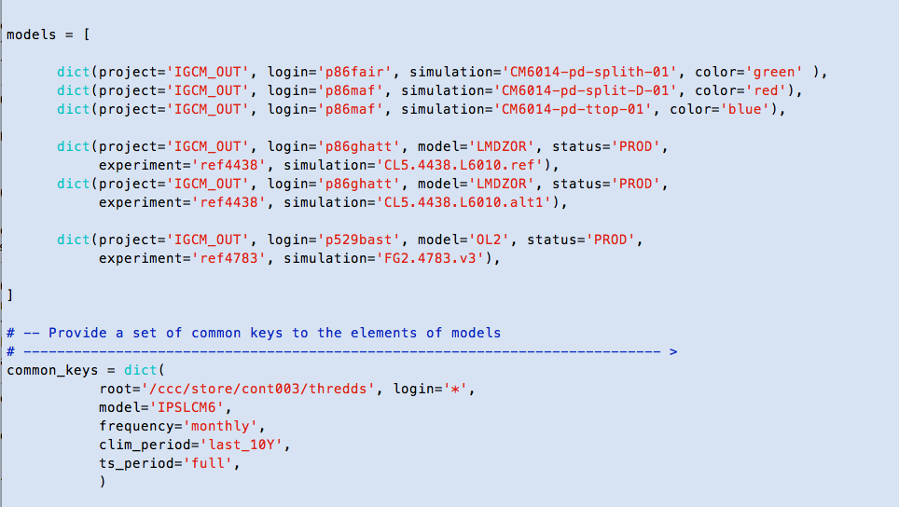
Adding your simulations
the python list ‘models’

Slide 13
Link between dataset and project
Demystify the CliMAF project
Definition of a project: example with an ORCHIDEE simulation (same pattern as ‘IGCM_OUT’ project):
# -- Define the path/filename pattern and include attributes
#/ccc/store/cont003/thredds/p529bast/IGCM_OUT/OL2/PROD/ref4783/FG3.4783.v4/SRF/Analyse/TS_MO/FG3.4783.v4_19790101_20091231_1M_tair.nc
pattern=‘${root}/${login}/IGCM_OUT/${model}/${status}/${experiment}/${simulation}/*/${OUT}/${frequency}/${simulation}_YYYYMM_YYYYMM_${frequency}_${variable}.nc’
# -- Declare that the project ‘ORCHIDEE’ takes the following attributes
cproject(‘ORCHIDEE’, (‘frequency’,’monthly’), ‘root‘, ‘login’, ‘model’, ‘status’, ‘experiment’, ensemble=[‘model’,’simulation’],separator='%')
# -- Finalize the ‘ORCHIDEE’ project
dataloc(project=‘ORCHIDEE’, organization=‘generic’, url=pattern)

Slide 14
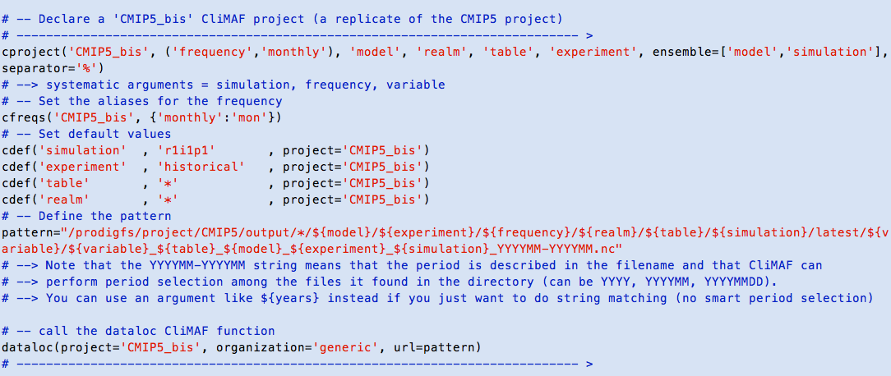
Add your own project
Example provided in datasets_setup

Slide 15
The 'IGCM_OUT' project
Example with the 'IGCM_OUT' data structure
The 'IGCM_OUT' CliMAF project provides access to the data structure of the libIGCM model outputs, like LMDz, ORCHIDEE, NEMO, PISCES (and subsequently, LMDZ-OR, and IPSLCM models)
Here is a typical example of an IGCM_OUT dataset definition:
models = [
dict(project = 'IGCM_OUT',
root = '/ccc/store/cont003/thredds',
login = 'p86caub',
model = 'IPSLCM6',
simulation = 'CM605-LR-pdCtrl01',
frequency = ’monthly',
clim_period = ‘last_20Y'
)
]

Slide 16
The 'IGCM_OUT' project
Example with the 'IGCM_OUT' data structure
CliMAF is searching your file among those patterns:
${root}/${login}[/IGCM_OUT]/${model}/${status}/${experiment}/
${simulation}/${DIR}/${OUT}/${ave_length}/
${simulation}_YYYYMMDD_YYYYMMDD_${frequency}_${variable}.nc
${root}/${login}[/IGCM_OUT]/${model}/${status}/${experiment}/${simulation}/${DIR}/${OUT}/${frequency}${clim_period_length}/
${simulation}_${frequency}_${clim_period}_1M_${variable}.nc

Slide 17
Project IGCM_OUT
Available keys
The available keys and default values are:
- root = '/ccc/store/cont003/thredds' # path (without the login)
# to the top of the IGCM_OUT tree
- login = '*' # login of the producer of the simulation
- model = '*' # explicit
- experiment = '*' # piControl, historical, amip...
- status = '*' # DEVT, PROD, TEST
- simulation = '*' # name of the numerical simulation
# (JobName in the IGCM syntax)
- DIR = '*' # ATM, OCE, SRF...
- OUT = 'Analyse' # or 'Output'
- frequency = 'monthly' # daily, annual_cycle (equivalent to 'seasonal')
- ave_length = 'MO' # MO, DA (optionnal, but can reduce the
# duration of the localization by ds() )
- period = 'fx' # explicit
- clim_period = '????_????' # explicit
- clim_period_length = '' # can be set to '_50Y' or '_100Y' to access
# the annual cycles averaged over 50yr long
# or 100yr long periods

Slide 18
The 'CMIP5' CliMAF project
Example with the 'CMIP5' data structure
If you set this in datasets_setup.py:
models = [
dict(
project = 'CMIP5',
model = 'IPSL-CM5A-LR',
experiment = 'historical',
simulation = 'r1i1p1',
frequency = 'monthly',
period = '1980-2005'
)
]
You will make use of this pattern:
/prodigfs/project/CMIP5/output/*/${model}/${experiment}/${frequency}/
${realm}/${table}/${simulation}/${version}/${variable}/
${variable}_${table}_${model}_${experiment}_${simulation}_${period}.nc
To access this file
/prodigfs/project/CMIP5/output/IPSL/IPSL-CM5A-LR/historical/mon/
atmos/Amon/r1i1p1/latest/tas/
tas_Amon_IPSL-CM5A-LR_historical_r1i1p1_185001-200512.nc

Slide 19
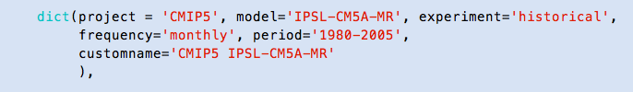
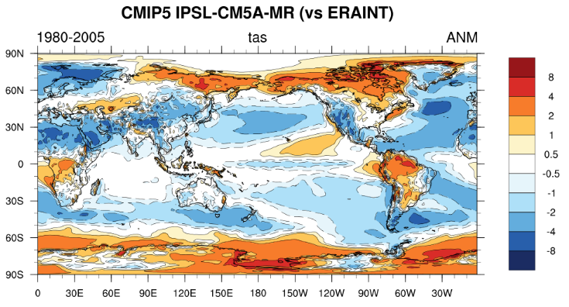
Name in the plot
Bonus: provide a customname to be used in the plots
Customname: you can provide a customname in the dataset dictionary that will be used in the plots

Slide 20
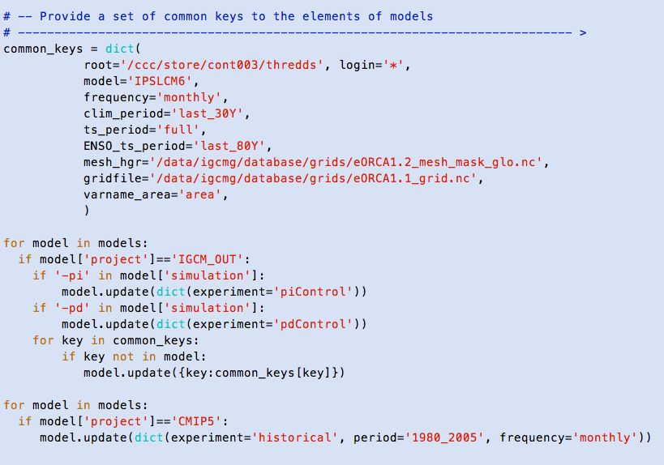
Using common keys
Specify common keys by project
We can specify keys that are common to a subset of the datasets in models using the python features. More generally, we can ‘work’ the elements of the list models within datasets_setup.py
This is for the IGCM_OUT datasets
The principle is to loop over the elements of model and ‘update’ the dictionary when certain conditions are met
And this is for CMIP5

Slide 21
Period manager

Slide 22
The period manager
clim_period and ts_period
The C-ESM-EP is composed of 'climatology diagnostics' (like bias maps) and 'time series diagnostics' (like the AMOC index or ENSO diagnostics).
Because of this, the user might want to provide one period for the climatologies, clim_period, and one for the time series, ts_period.
The period manager can understand those values (either for clim_period or ts_period) if frequency=‘monthly’:
‘last_30Y’, ‘first_1Y’
‘full’
By default, the C-ESM-EP will search for the period corresponding to the user request for each diagnostic.
Warning : this works for CMIP5, IGCM_OUT and CMIP6 projects.
Contact me if you need me to add your project to the list (I need to find a better way to handle that)

Slide 23
Set ts_period and clim_period
Discard period_manager to keep the same periods
The systematic search for the available data with the period manager for each diagnostic can be time consuming and not necessary.
If you want to:
Speed up the execution of the atlas (discard the period availability check for each diagnostic and just do it once for all)
Keep the same period from one execution of the atlas to the next (especially on an ongoing simulation, from one day to another)
you can apply the period manager only once for a comparison using set_available_period_ts_clim.py:
python set_available_period_ts_clim.py comparison/ [variable]
=> It will apply the period manager and find both the ts and clim periods when necessary (requested by the user)

Slide 24
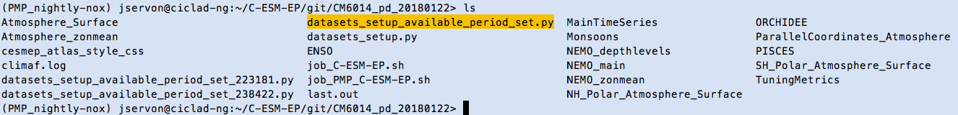
Set ts_period and clim_period
Discard period_manager to keep the same periods
It creates a file datasets_setup_available_period_set.py in the comparison directory, containing the ‘true’ clim_period and ts_period (real dates). If this file exists, the C-ESM-EP will use it instead of datasets_setup.py to specify the datasets, and not apply the period manager.
Simply remove it if you want to come back to normal.
If there is already a file in the directory, it will make a copy of it so that you can use this backup it afterwards.
The file datasets_setup_available_period_set.py is the last file produced by set_available_period_ts_clim.py and is the one that is used by the C-ESM-EP.

Slide 25
Set ts_period and clim_period
Discard period_manager to keep the same periods
By keeping the same periods from one day to the next, a big advantage is that you make use of the existing results in the cache (if you have no scientific or practical reasons to update the periods of study).
This is particularly interesting when working interactively: you do not loose time searching for available results every time you run the atlas.
You can also use this tool as a way to check if your dataset specification is correct: if you provide a variable as last argument to the script, it will actually try to get the files corresponding to the user list of datasets for this variable, and return an error if it doesn’t find it.
python set_available_period_ts_clim.py comparison/ tas
This way you can fix minor errors before running the big atlas.

Slide 26
One word on colors

Slide 27
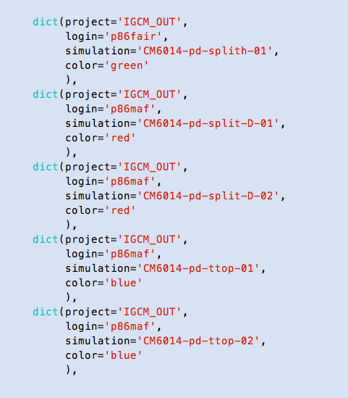
Providing colors
For MainTimeSeries, Par.Coord., Hotelling and TuningMetrics
You can specify a color with a dataset with the argument color:
This color will be used to identify the dataset in MainTimeSeries, Parallel Coordinates, the Hotelling Test and the Tuning Metrics.
If you don’t specify the color, the C-ESM-EP will automatically attribute one to the dataset.
You can use:
blue, red, green
An integer (1, 3, 10)
Any python color:
https://stackoverflow.com/questions/22408237/named-colors-in-matplotlib

Slide 28
Typical errors

Slide 29
Tracking down errors
The common errors
If you have an error with your atlas, go through the typical checks listed in the error page:
If you haven’t been able to correct the error, contact jerome.servonnat@lsce.ipsl.fr and provide:
The error
The path to your comparison

Slide 30
The compareCompanion

Slide 31
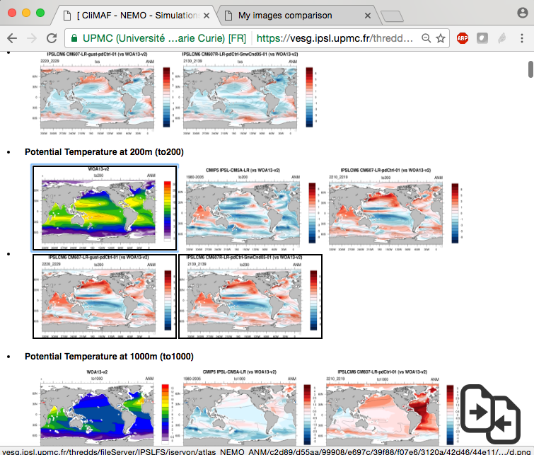
The compareCompanion
Select your figures with 's'
Select the images by putting the mouse over the plots and press 's' (for 'select')
A black line is drawn over the selected plots

Slide 32
The compareCompanion
Select your figures with 's'
Click on the bottom right icon…

Slide 33
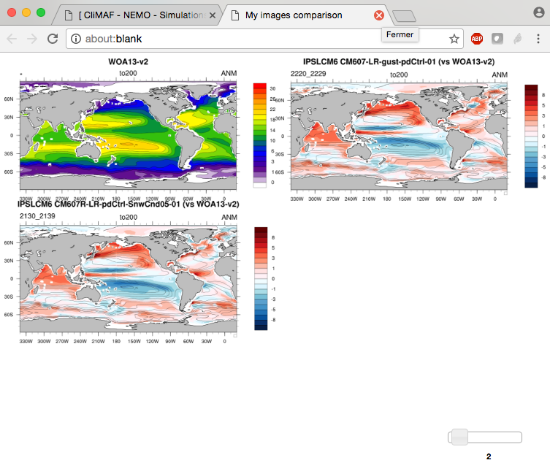
The compareCompanion
Display a selection of figures on the fly
Here is your selection of plots!
Control the number of columns with the slider…
And switch their positions by dragging the image you want at the position of your choice

Slide 34
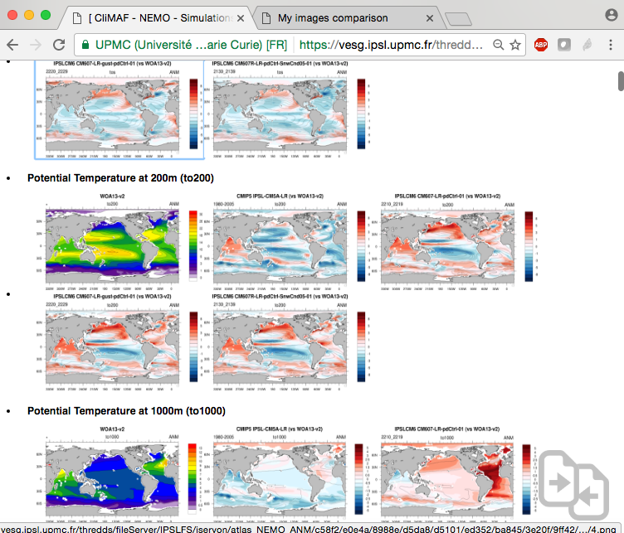
The compareCompanion
Clear the selection
Clear the compareCompanion cache by pressing 'c' (for 'clear')…
… and restart with a new selection.

Slide 35
Questions? jerome.servonnat@lsce.ipsl.fr

Slide 36
The CliMAF Earth System Model Evaluation Platform, 2017
J. Servonnat, S. Sénési, L. Vignon, O. Marti, P. Brockmann, S. Denvil
Contributors:
F. Hourdin, I. Musat, M.P. Moine, E. Sanchez, M. Chevallier, R. Msadek, J. Deshayes, M. Van Coppenolle, C. Rousset, J. Mignot, J. Ghattas, P. Peylin, N. Vuichard, P. Cadule, A. Ducharne, F. Maignan, R. Séférian
Beta-testers:
O. Marti, J. Mignot, J. Deshayes, P. Braconnot, P. Sepulchre, M. Kageyama, S. Denvil, R. Séférian, A. Cozic
The authors would like to give special credit to A. Voldoire for showing the way for CliMAF, and to F. Hourdin and the LMDz team for the structure of the C-ESM-EP that is largely inspired from the LMDz evaluation atlas.

